Slide 1

BRACT’S,
Vishwakarma Institute of Information Technology, Pune-48
(An Autonomous Institute affiliated to Savitribai Phule Pune University)
(NBA and NAAC accredited, ISO 9001:2015 certified)
Department of Information Technology
Subject: Final Year Major Project
Topic:- Road Pothole Detection and Reporting System
Presented by,
1.Pranav Khaire(432027)
2.Sanket Mahajan(432032)
3.Pushkar Pawar(432042)
4.Sahil Pawar(432043)
Class: BTECH_B_(IT)
Academic year: 2024-2025
Guide name:-
Dr. Suruchi Dedgaonkar

Slide 2
INDEX
Abstract
Introduction
3) Comparison
4) Why Use CNN for Pothole Detection Instead of YOLO
5) Methodology / algorithms / techniques used
6) Proposed System Snapshots
7) Proposed Outcomes
8) References
Department of Information Technology, VIIT , Pune-48

Slide 3

Abstract
Objective Develop a real-time pothole detection and navigation system to improve road safety and maintenance.
Technology High-resolution cameras and machine learning for automated pothole detection and reporting.
Data Management Centralized server analyzes pothole data for actionable insights.
User Integration Real-time alerts and route optimization to help drivers avoid potholes.
Impact Reduces manual inspections, improves accuracy, and enhances road quality and user experience.
Department of Information Technology, VIIT , Pune-48

Slide 4
Introduction
Purpose:
To create an automated system for detecting potholes in road images using YOLO.
Reduces manual inspections, ensuring timely repairs and reducing road accidents.
Motivation:
Potholes are a major cause of vehicle damage and road accidents.
Automating detection can significantly improve road maintenance efficiency.
Scope:
System integrates deep learning with a web interface for real-time pothole detection.
Handles large datasets from sources like dashcams and drones.
Department of Information Technology, VIIT , Pune-48

Slide 5
Comparison of existing systems
Title & Year | Methodology | Gap / Limitation
Pothole Detection and Reporting System Using Deep Learning (2011) | - Applied Research and Rapid Application Development. - Smartphone image capturing and YOLO v5 for analysis. | - Limited data collection due to image capture methods. - Coverage issues with different angles/scenarios.
Pothole Detection with YOLO V8 (2013) | - YOLO v8 applied to a dataset of 2000+ images. - Mobile-based pothole detection and visualization. | - Detection model performance varies in different conditions. - Complex compared to other object detection tasks.
Real-Time Pothole Detection Using Deep Learning (2014) | - Applied SSD TensorFlow, YOLOv3, and YOLO v4 on a large dataset. - YOLO v4 showed best performance (20 FPS, 100m range). | - Requires a more diverse dataset (roads, lighting, weather). - Dataset limitations affect real-time detection accuracy.
Department of Information Technology, VIIT , Pune-48

Slide 6
Why Use CNN for Pothole Detection Instead of YOLO
Simplicity of Implementation:
Easier to implement and train for binary classification tasks.
Data Availability:
More effective with smaller datasets; requires fewer annotated examples.
Hierarchical Feature Learning:
Excels at identifying intricate patterns and textures specific to potholes.
Resource Constraints:
Requires less computational power, enabling real-time processing on modest hardware.
Focus on Classification:
Directly outputs class probabilities, simplifying the model’s interpretation.
Department of Information Technology, VIIT , Pune-48

Slide 7
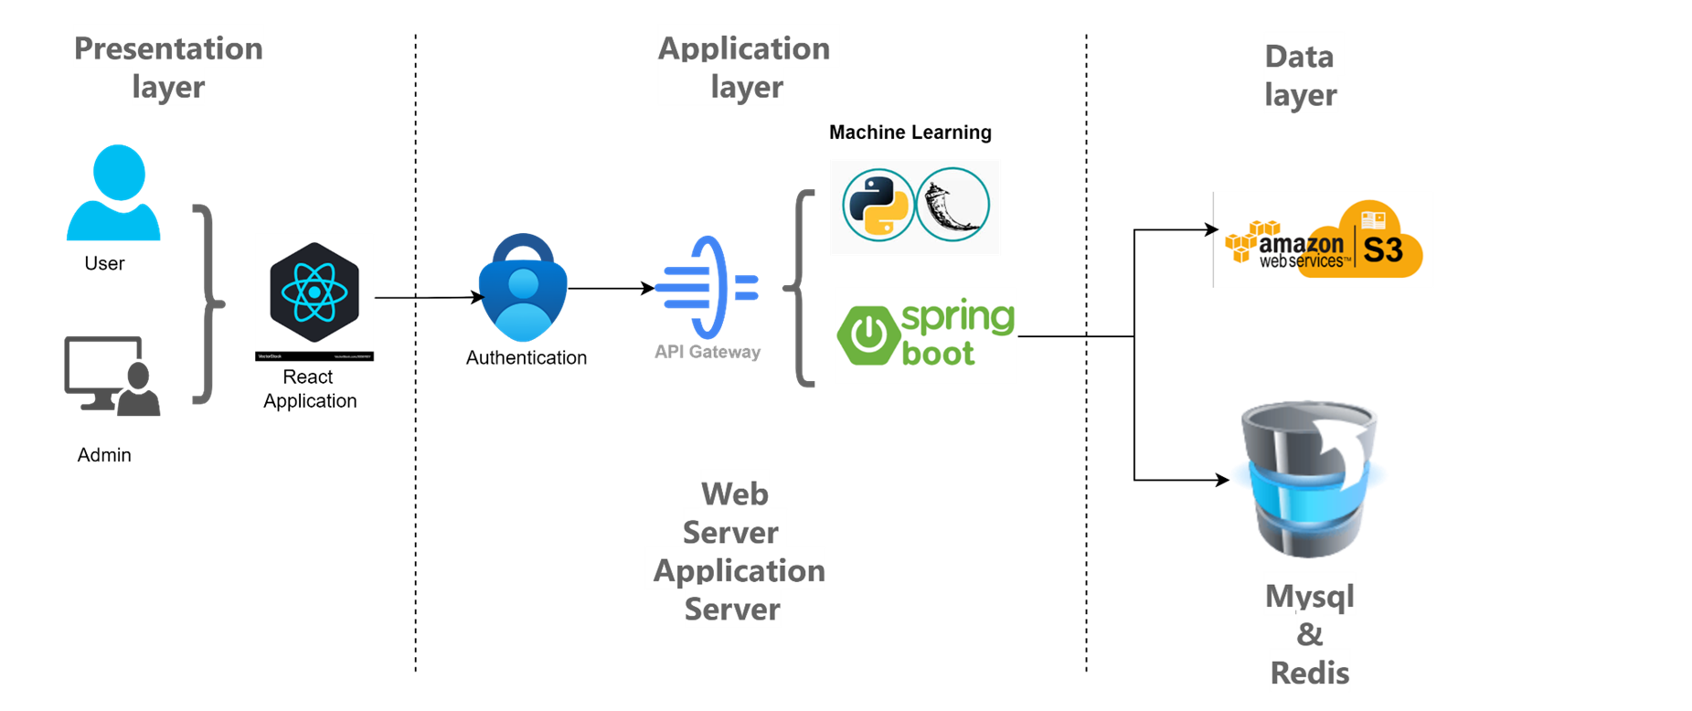
Architecture
Department of Information Technology, VIIT , Pune-48

Slide 8
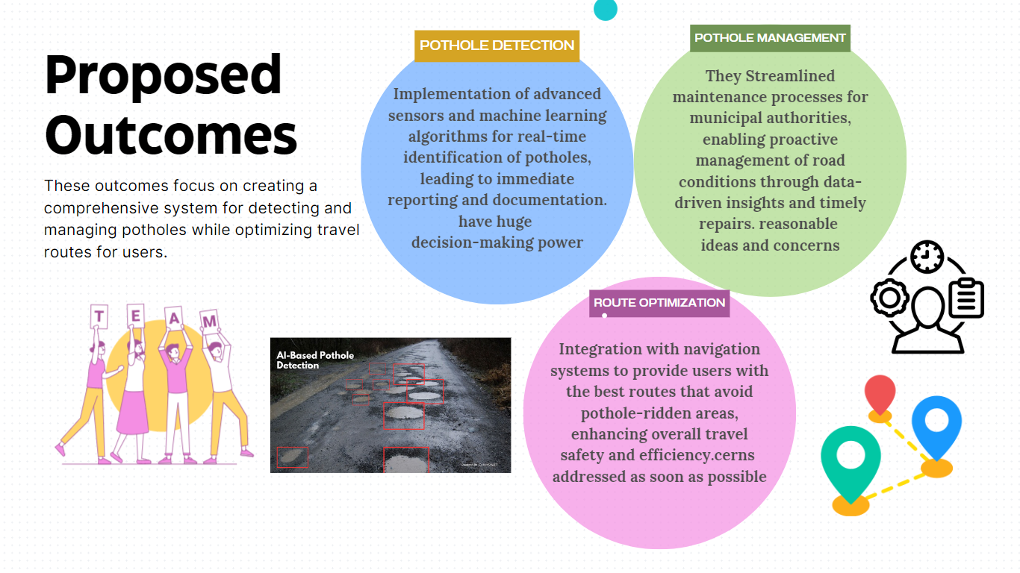
Department of Information Technology, VIIT , Pune-48

Slide 9


System Snapshots (Home Page)
Department of Information Technology, VIIT , Pune-48

Slide 10
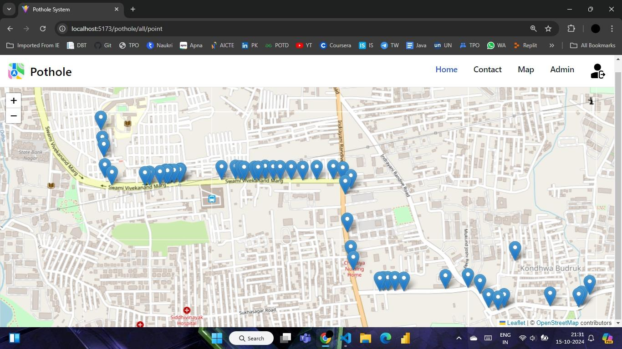
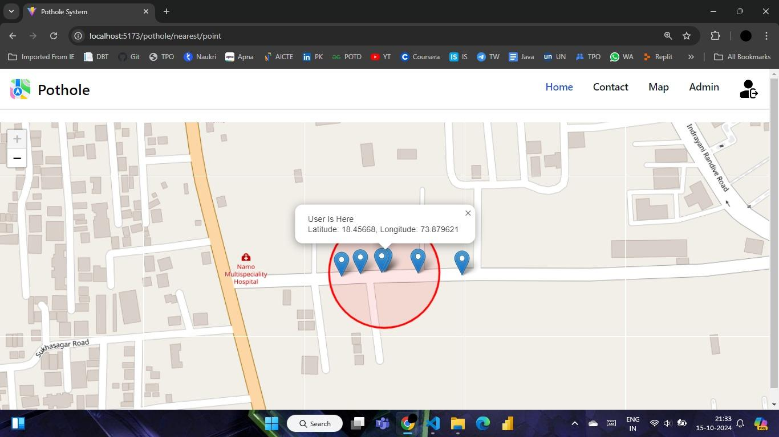
System Snapshots (Home Page)
Department of Information Technology, VIIT , Pune-48

Slide 11
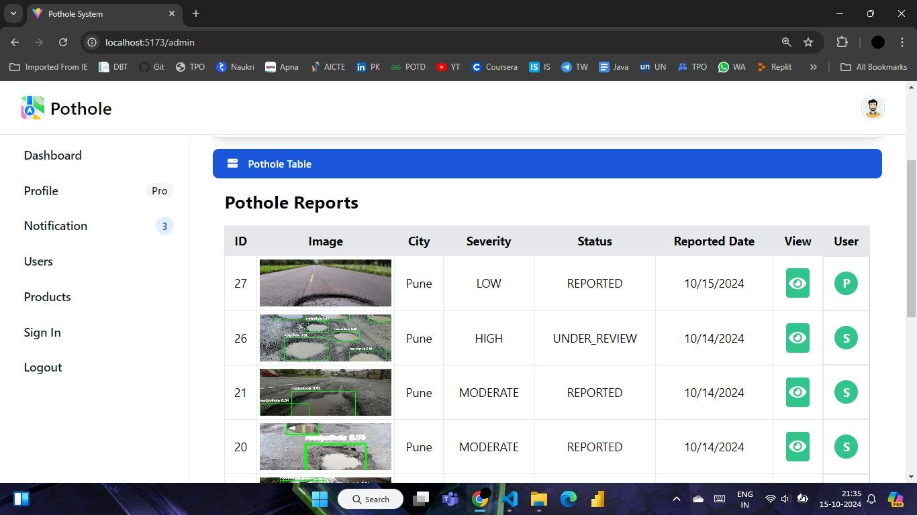
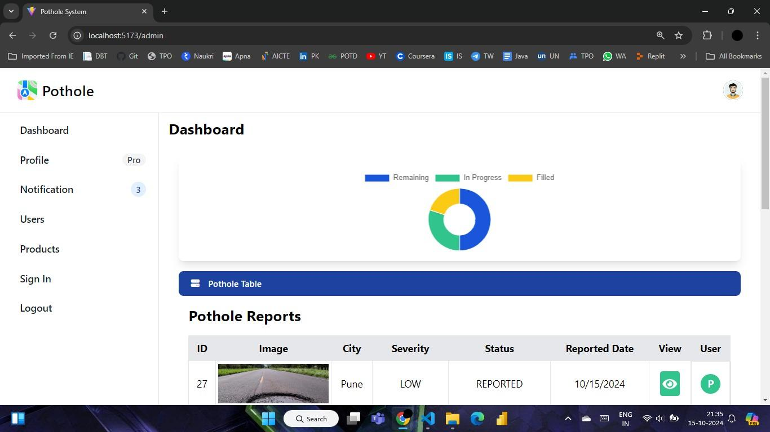
System Snapshots (Home Page)
Department of Information Technology, VIIT , Pune-48

Slide 12
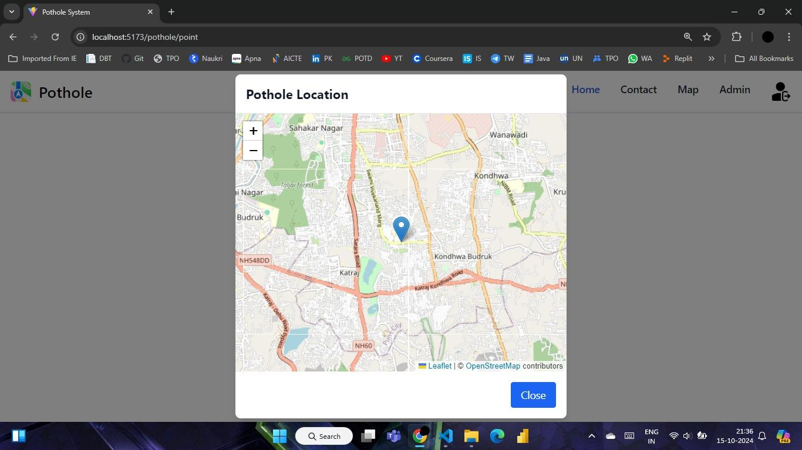
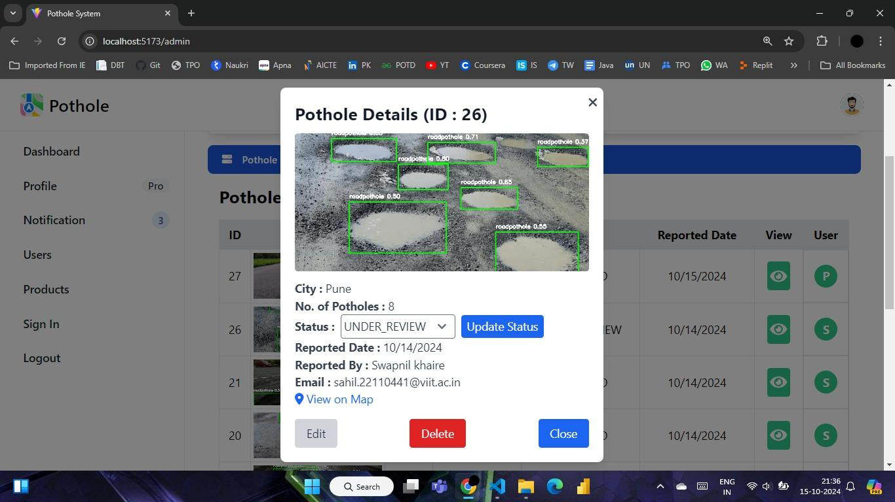
System Snapshots (Navigation Page)
Department of Information Technology, VIIT , Pune-48

Slide 13
References
Al-Shaghouri, A., Alkhatib, R., & Berjaoui, S. (2019). Real-time pothole detection using deep learning.
Dasgupta, A., Gupta, A., & Mitra, A. (2020). Pothole detection using image processing and machine learning techniques.
Mednis, S., Elsts, A., Strazdins, G., Zviedris, R., & Selavo, L. (2011). Real-time pothole detection using Android smartphones with accelerometers.
Zhang, Y., Wu, K., & Zhang, F. (2016). Pothole detection using mobile crowdsensing.
Rajeshwari S. K., Santhosh S. H. (2014). "Pothole Detection and Warning System Using Embedded System". International Journal of Emerging Technology and Advanced Engineering, 4(8), 570-575.
Kumar S., Anand A. (2019). "Pothole Detection Using Machine Learning on Real-time Data". Journal of Intelligent Transportation Systems, 23(5), 455-467.
Department of Information Technology, VIIT , Pune-48

Slide 14
References
7. Mednis A., Strazdins G., Zviedris R., Kanonirs G., Selavo L. (2011). "Real Time Pothole Detection Using Android Smartphones with Accelerometers". Proceedings of the International Conference on Distributed Computing in Sensor Systems and Workshops, Barcelona, Spain, 1-6.
8. Yu B., Jia B., Xu M., Wu Y. (2016). "Pothole Detection and Evaluation Using Smartphones". Proceedings of the IEEE International Conference on High Performance Computing and Communications, Sydney, Australia, 1039-1044.
9. Eriksson J., Girod L., Hull B., Newton R., Madden S., Balakrishnan H. (2008). "The Pothole Patrol: Using a Mobile Sensor Network for Road Surface Monitoring". Proceedings of the 6th International Conference on Mobile Systems, Applications, and Services, Breckenridge, CO, USA, 29-39.
10. Li Y., Liu P., Yu Y., Wang W., Zhang Y. (2020). "Automatic Pothole Detection and Segmentation Based on Deep Learning". IEEE Transactions on Image Processing, 29, 9176-9185.
Department of Information Technology, VIIT , Pune-48

Slide 15

Department of Information Technology, VIIT , Pune-48

